Slide 1

Car Rental System
Car Rent Group
Web Application
University of Padova
Academic Year 2023/2024
Francesco Chemello, Elnaz Dolati, Gabriella Ingridy De Souza Farias, Luca Pellegrini, Seyedreza Safavi and Ahmad Sadin

Slide 2

Table of Contents
Introduction
Objectives and System Architecture
Backend
Frontend
Conclusion

Slide 3
Introduction

Slide 4
Introduction
Project Overview:
Our Car Rental Web Application is designed to streamline car rental operations, enhance customer experience, and optimize the management of rental activities.
The project incorporates a robust backend developed using Java and an interactive frontend utilizing HTML, CSS, JavaScript, jQuery, AJAX, and Bootstrap.
Technology Used:
Backend
Java
Servlets and RESTful APIs
Frontend
HTML/CSS /Bootstrap
JavaScript/jQuery
AJAX

Slide 5
Objectives and System Architecture

Slide 6
Objectives and System Architecture
Project Objectives:
Design and implement a robust web application
Enhance customer experience
Optimize car rental processes
Provide valuable insights
System Architecture:
Client-Server Model
Frontend
Backend
Architecture Components
Frontend: HTML, CSS, JavaScript, jQuery, AJAX, Bootstrap.
Backend: Java-based servlets and REST APIs.
Database: Manages data persistence and retrieval.

Slide 7
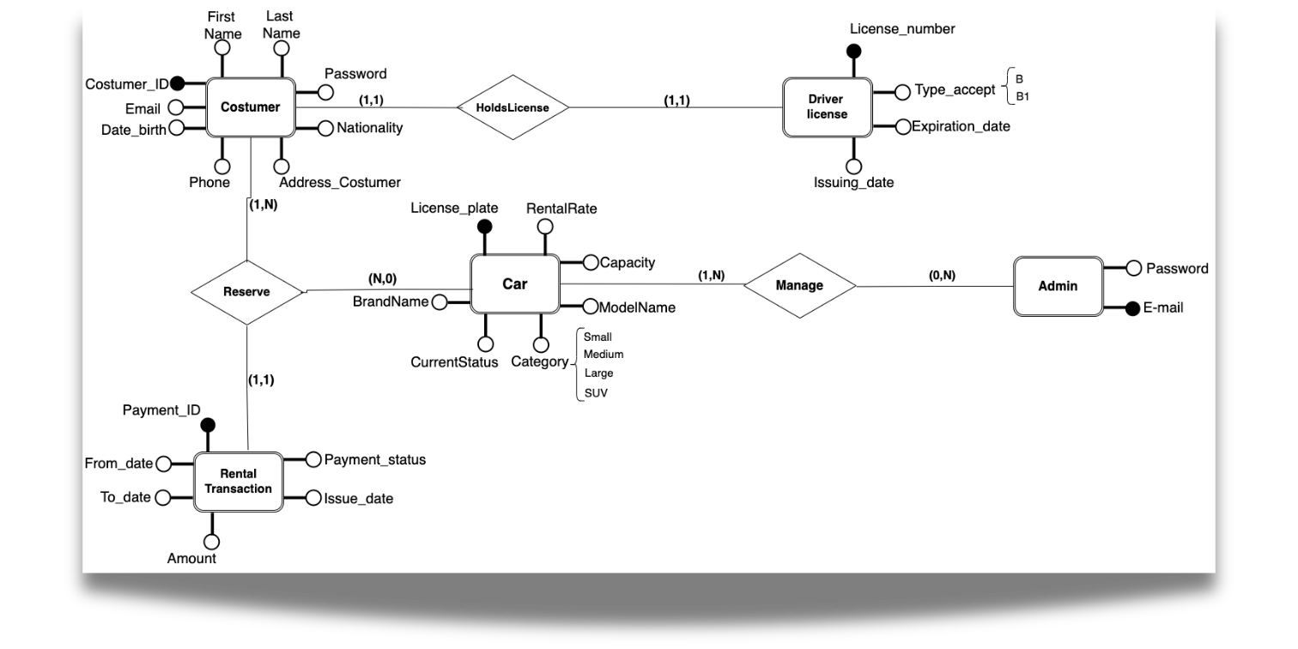
ER Schema

Slide 8
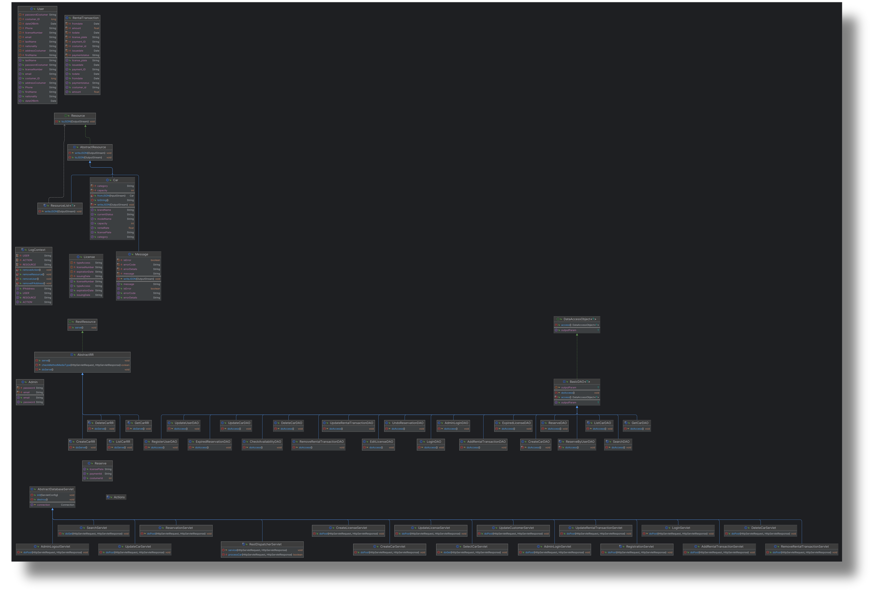
Class Diagram

Slide 9
Backend

Slide 10
Data Access Objects (DAO) Layer
Key DAO Classes:
AddRentalTransactionDAO.java: Handles adding new rental transactions to the database.
AdminLoginDAO.java: Manages admin login operations and authentication.
CreateCarDAO.java: Facilitates the creation of new car entries in the database.
ListCarDAO.java: Retrieves a list of cars available for rental.
LoginDAO.java: Handles user login operations.
RegisterUserDAO.java: Manages user registration and adds new users to the database.
UpdateCarDAO.java: Handles updates to car details in the database.
UpdateUserDAO.java: Manages updates to user information.

Slide 11
Service Layer
Key Service Classes:
Admin.java: Manages administrative tasks, including user and car management.
Car.java: Handles operations related to car information and availability.
User.java: Manages user-related functionalities, including registration and profile updates.
RentalTransaction.java: Oversees rental transactions, including reservations, modifications, and cancellations.
Reserve.java: Handles car reservation logic, ensuring availability and processing bookings.

Slide 12
Servlet Layer
Key Servlet Classes:
AddRentalTransactionServlet.java: Processes requests to add new rental transactions.
AdminLoginServlet.java: Handles admin login functionality.
CreateCarServlet.java: Manages requests to add new cars to the system.
LoginServlet.java: Processes user login requests.
RegistrationServlet.java: Manages user registration requests.
SearchServlet.java: Handles search functionality for available cars.
UpdateCarServlet.java: Processes requests to update car information.
UpdateCustomerServlet.java: Manages requests to update customer information.

Slide 13
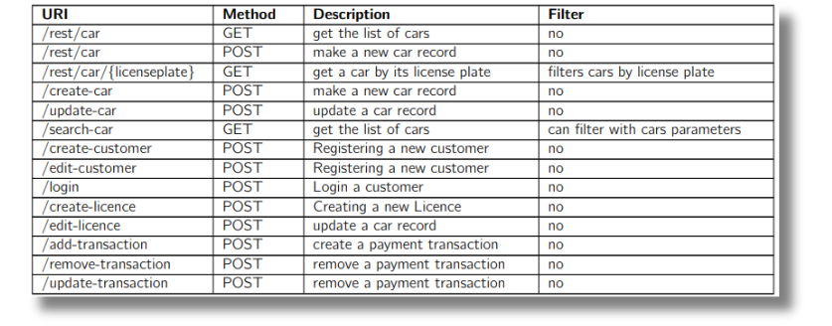
REST API

Slide 14
Payment API Integration (Stripe)
Why third party payment handler?
from security perspective it is better not to store or handle the payments info in our database because it will need a lot of work and security knowledge.
payments are a very repetitive part of all commerce websites and a well-known company like Stripe made it super easy to integrate with all languages and tech stacks.
Stripe will provide a very effective dashboard to manage the billings and payments history.

Slide 15
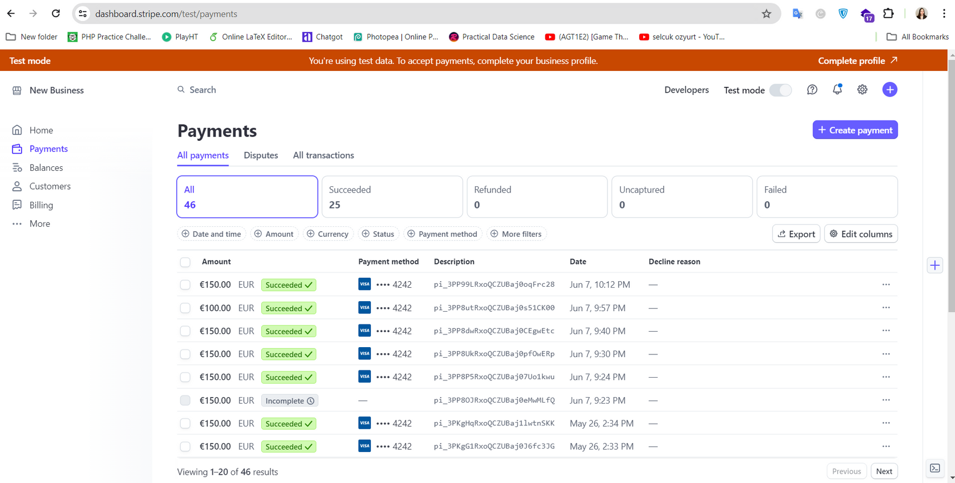
Stripe Dashboard

Slide 16
Payment API Integration (Stripe)
Steps and workflow of payments:
on reserve page with cdn of https://js.stripe.com/v3/ we initialized an object of stripe in JavaScript with Stripe Public Key
this object will make a call with post method to /create-payment-intent, fetching a payment intent(an object containing all payment data(amount from session not frontend, payment_id created with Stripe Java library).
on submit of payment form stripe js object will stablish an ssl secured connection to Stipe to handle the payment. if the card was real and payment succeed we persist the reservation in database and redirect user to success page. in case of error we render the error returned on payment form.

Slide 17
Front - End

Slide 18
Front-End Technologies
Purpose:
The frontend of our Car Rental Web Application provides a user-friendly interface for customers and admins to interact with the system. It handles user input, displays data, and ensures a seamless user experience.
Technologies Used:
HTML: Structures the web pages.
CSS: Styles the web pages for a visually appealing look.
JavaScript: Adds interactivity and dynamic behavior to the web pages.
jQuery: Simplifies DOM manipulation and AJAX requests.
AJAX: Enables asynchronous data loading, improving user experience by avoiding full page reloads.
Bootstrap: Ensures a responsive design that works across various devices and screen sizes.

Slide 19
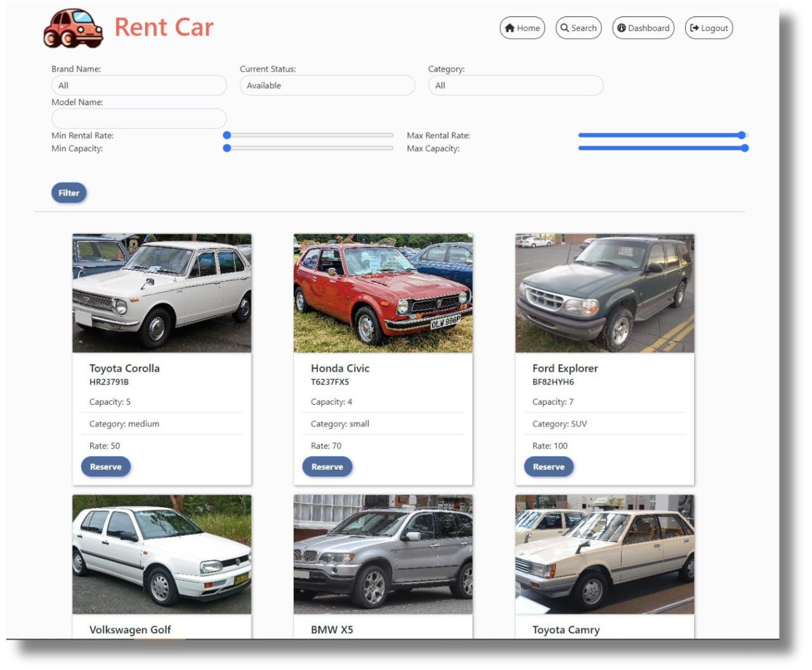
Home / Displaying All cars

Slide 20
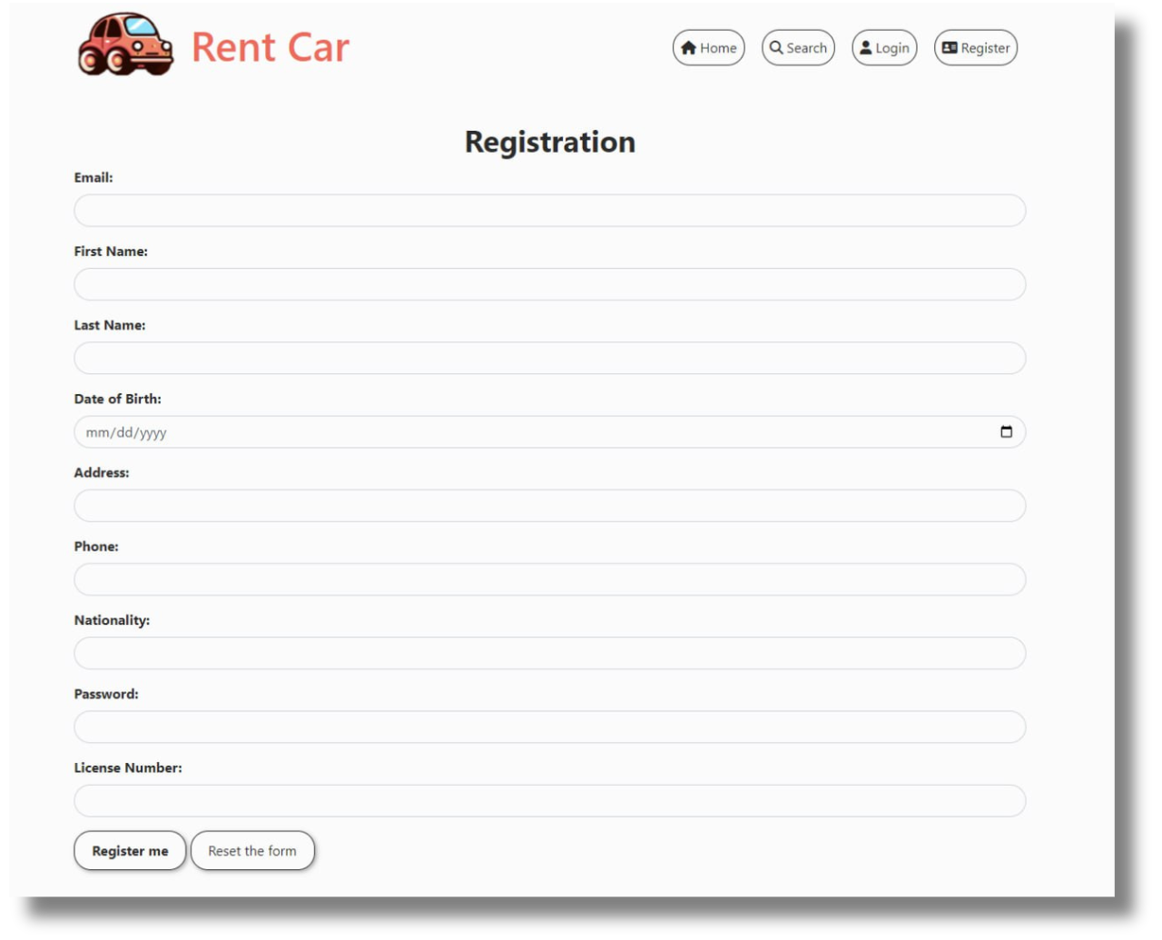
Registration Page

Slide 21
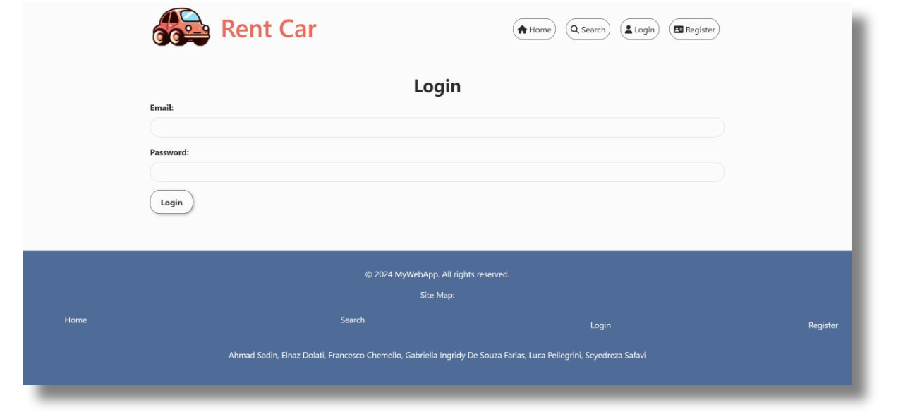
Login Page

Slide 22
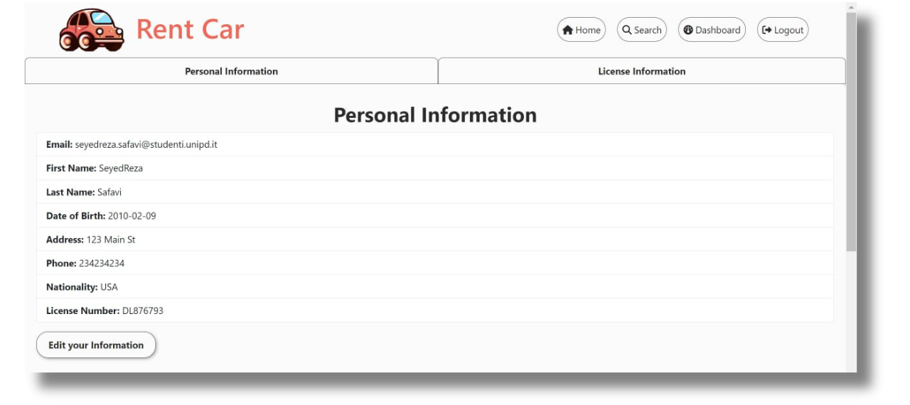
User Panel

Slide 23
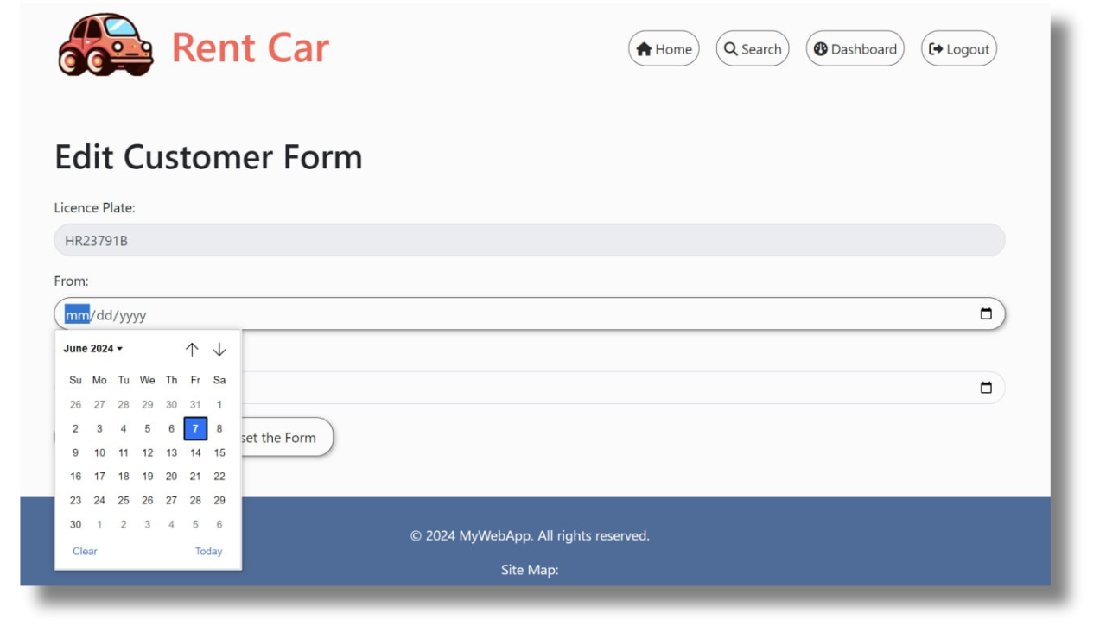
Reservation / First Stage

Slide 24
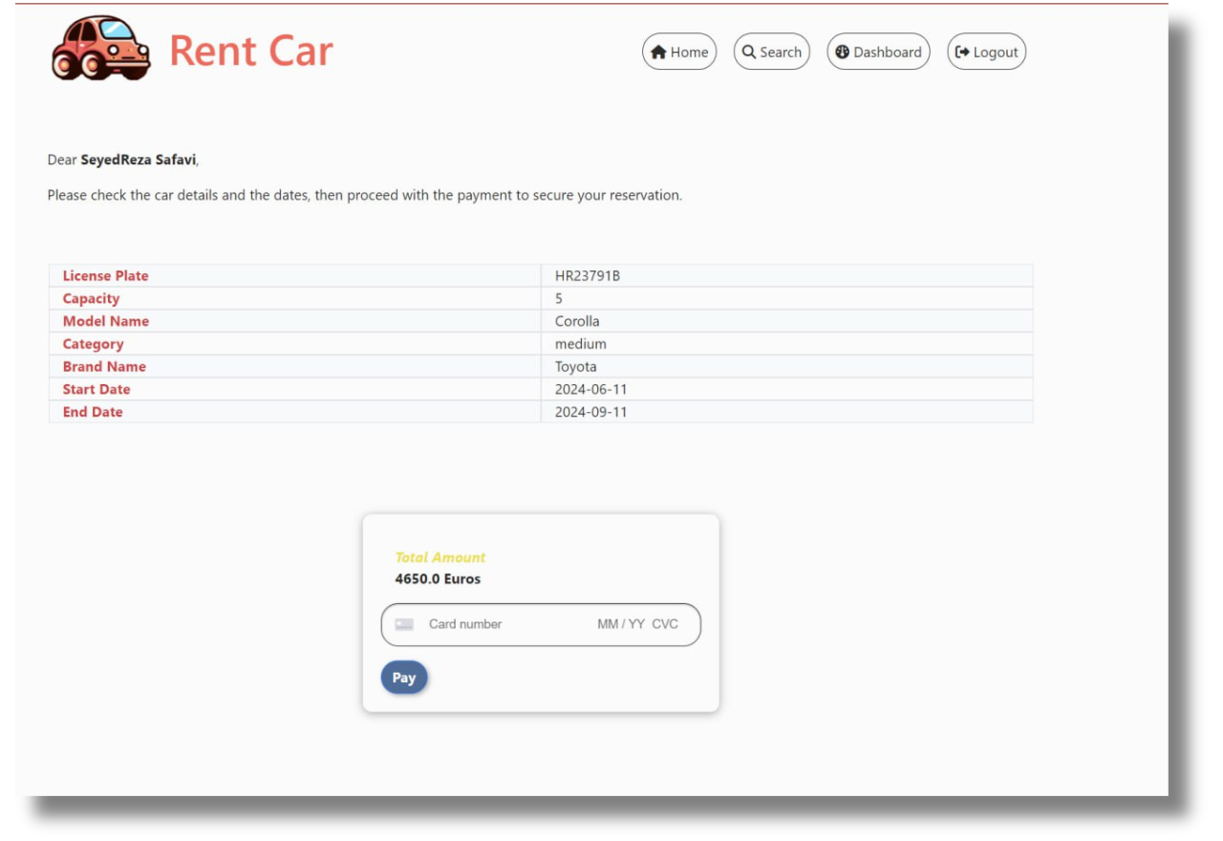
Reservation / Second Stage

Slide 25
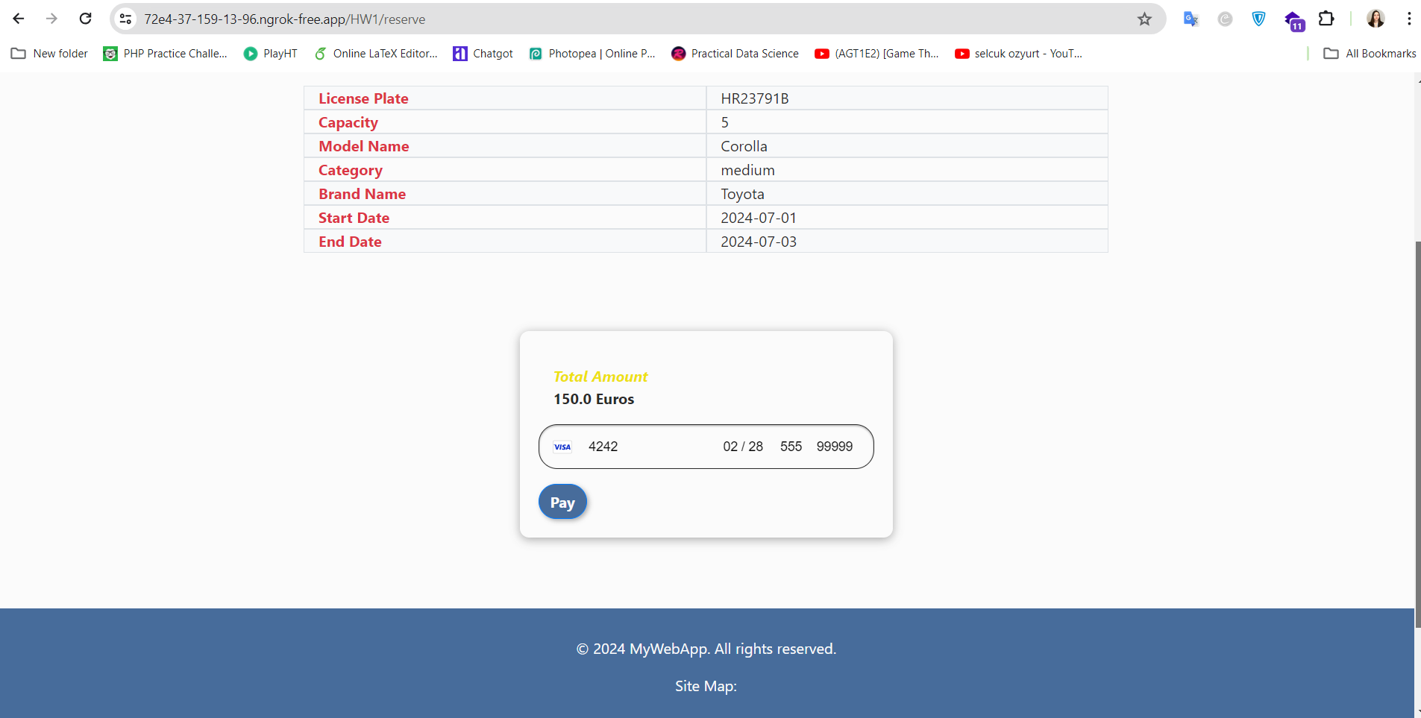

Reservation / Second Stage
Pay

Slide 26
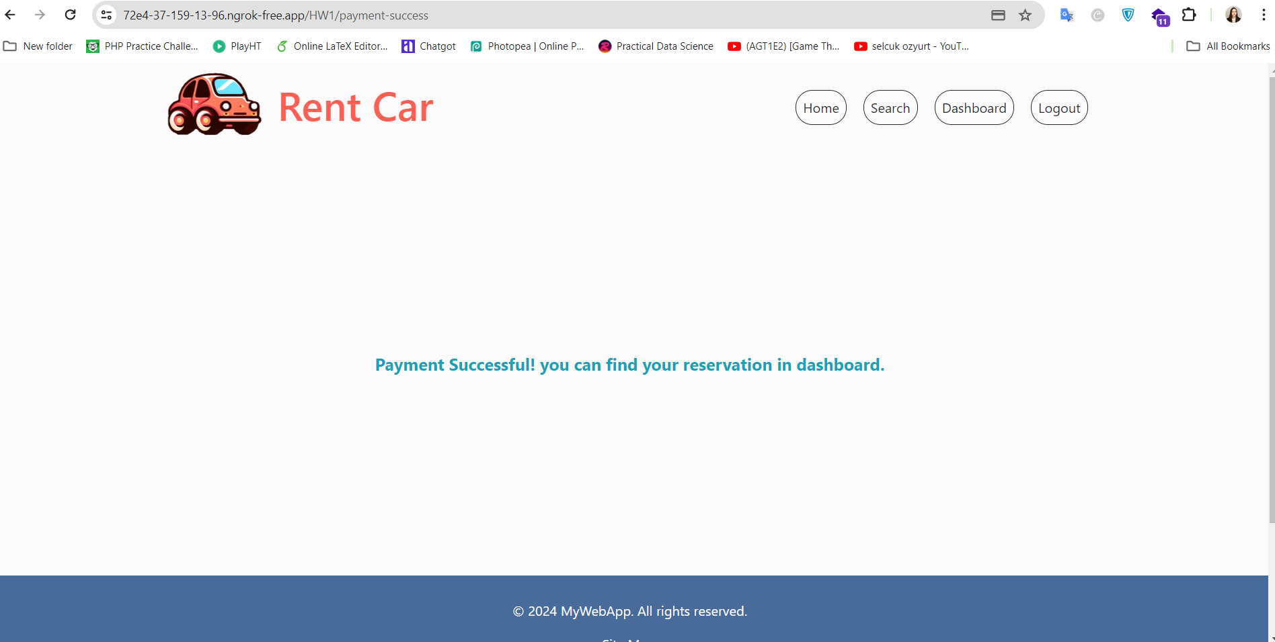
Reservation / Third Stage

Slide 27
Conclusion / Future Works

Slide 28
Conclusion
Summary
Streamlined car rental operations and enhanced customer experience.
Integrated robust backend services with an interactive frontend.
Achievements
Implemented core functionalities with data integrity and security.
Developed a responsive and intuitive user interface.

Slide 29
Future Works
Enhancements
Advanced search capabilities, availability calendars, and personalized recommendations.
Review and rating system for feedback and service improvement.
Expanded administrative functionalities for user management and reporting.
Technological Advancements:
Adoption of machine learning and AI for pricing optimization and demand prediction.
Continuous refinement of frontend technologies for improved user experience.
Community Engagement:
Collaboration with industry experts for feedback and feature prioritization.
Participation in events to stay updated on industry trends and foster innovation.

Slide 30
Thank You!
ANY QUESTIONS?

